Slide 1
Dealing with Loss and Disappointment: If You Suspend Your 2020 Season
with Bob Ditter May 2020

Slide 2
A Few Brief Words Before We Get Started
My intention with these two webinars is to help you think ahead about how you can best deal with whatever you eventually decide about camp for this summer
I am not here to try and influence your decision
Every camp must make their own decision using the best available information at the time
There is some “chatter” out there about how individual camps are looking at their options. I’d like to address that briefly.

Slide 3
A Few Brief Words Before We Get Started
Whether to open or not is a huge decision that every owner/director must make for themselves.
That decision carries with it the huge burden of responsibility for the safety of both staff and other people’s children
It is a decision that has many dimensions, both in terms of your livelihood, your sense of purpose & health and safety of others.
If you are taking your time with that decision, it’s no wonder!

Slide 4
A Few Brief Words Before We Get Started
In these times the stakes are high and emotions are raw. It is even more important to respect the final decisions of other camp professionals
Every camp has its own unique set of circumstances
We can’t control the fact this virus is here or the economic and social environment it has created. It’s here and it’s happening!
We can control how we respond and how we practice respect for one another —and resist the impulse to judge!

Slide 5
A Few Brief Words Before We Get Started
A few truths:
There is a burden of responsibility for the safety of staff and campers that will be made at some level
Some camp operators have said privately that they hope their State will make the decision so they don’t have to!
If States give the green light, that burden gets passed to camps
Even if a camp opens, each parent carries the burden of the decision for their own children (as each staff member must do for themself!)

Slide 6
Overview of My Remarks
A Basic Guideline for Deeper, More Effective Communication
Some thoughts about what you might say to campers and families if you decide not to operate this summer
Some thoughts about what to say to your staff should you decide not to operate this summer
Some tips to help parents help their children with the Loss and disappointment of possibly losing their camp experience

Slide 7
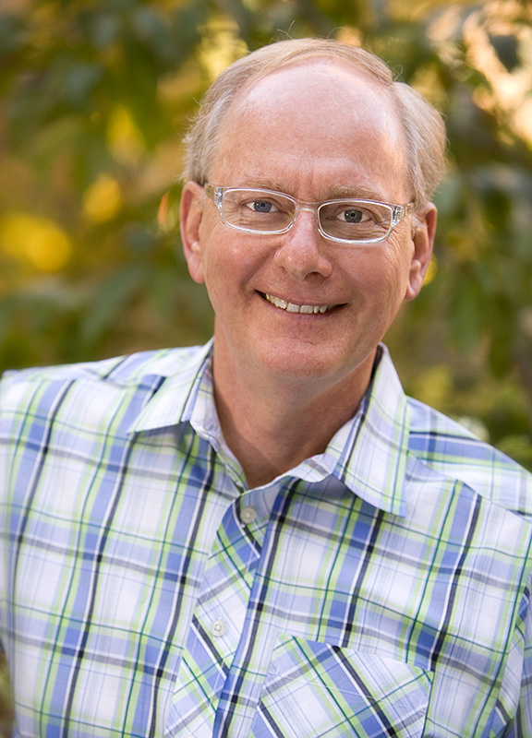
Thank You for the Opportunity

Slide 8
Thank You for the Opportunity
It is not the opportunity I would have preferred

Slide 9
Thank You for the Opportunity
The opportunity I would have preferred…

Slide 10
Thank You for the Opportunity
The opportunity I would have preferred…
Would be to be standing in your presence

Slide 11
The “Absence of Presence”
That lack of being in one another’s presence, where we sense each other’s vitality, is what we all miss!
It is in one another’s presence that the
magic of camp (all relationships) happens!

Slide 12
The Opportunity We Have
I say this for three reasons:
To make an important point about how to communicate more deeply and effectively→ to share apart of yourself
To draw a comparison to what campers are dreaming of right now (which you will need to acknowledge in order to be heard!)
To emphasize that even though the opportunity we have is not the opportunity we want, it is still the opportunity we have!

Slide 13
To Communicate More Deeply & Effectively
Always start by acknowledging what people are experiencing.
This is the reality of their inner world.
It is what I mean by “connect before you redirect!”
It is how we validate others: to have them feel heard

Slide 14
To Communicate More Deeply & Effectively
Another person more famous than I has called it the “charity” part of effective communication.
Allow me to explain…

Slide 15
A Brief Story

Slide 16
A Brief Story

Slide 17
A Brief Story

Slide 18
A Brief Story
Ted Sorenson

Slide 19
A Brief Story
Ted Sorenson President John F Kennedy

Slide 20
A Brief Story
Charity
Clarity
Brevity
Levity

Slide 21
A Brief Story
Charity
Be charitable to your audience.
Acknowledge their good works, their mission, their passion, their reality.
In other words, connect with them first!

Slide 22
A Brief Story
Clarity
Be clear. You want to have an impact,
not just make people feel good. Making strong points can move an audience to action, give them direction & energize!

Slide 23
A Brief Story
Brevity
Be brief. You don’t want to wear out your audience! Make a few points clearly and
stop talking! Doing more than that takes away from the force of your talk.

Slide 24
A Brief Story
Levity
Even difficult subjects can benefit from a sense of humor.
Levity doesn’t always mean “funny.”
It can mean giving people hope or courage as well.

Slide 25
To Communicate More Deeply & Effectively
With regard to campers it would be important to acknowledge what they might be going through:
the loss of school
not being with friends
Maybe a parent who has lost a job or their business
possibly having lost a grandparent to the virus, and…
…their wish to be at camp…

Slide 26
The Same Opportunity Campers Want!
…to build and be nurtured by friendships…

Slide 27
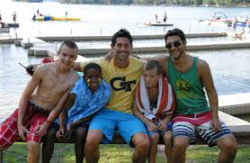
The Same Opportunity Campers Want!
…to be in a community that supports you…

Slide 28
The Same Opportunity Campers Want!
…to be in the company of interesting, caring adults…

Slide 29
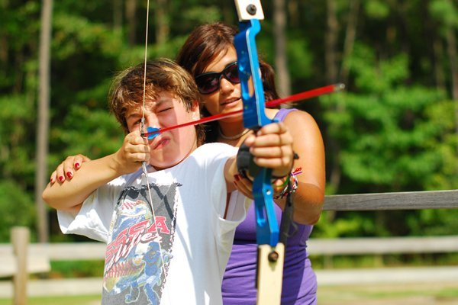
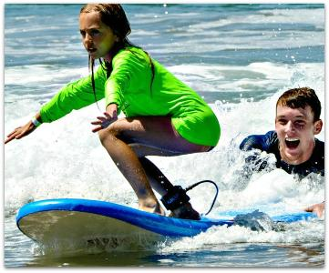
The Same Opportunity Campers Want!
…to get “lost in the flow” of camp moments…

Slide 30
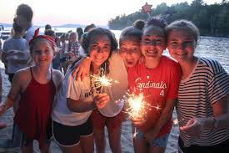
The Same Opportunity Campers Want!
…to look back at the end and say, “I did it myself!”

Slide 31
“Charity” is Usually First
Validating what will be lost/what has been lost:
We all ache for camp
We yearn for our friends
We miss our community
Name camp specific traditions that everyone looks forward to

Slide 32
In This Case…Clarity First!
Your camp families (and your staff!) are on the edge of their seats! No need to “create a listening!”
Our decision is based on your child’s safety (and that of our staff).
Your child’s safety and the safety of everyone at camp comes first!
If we could have done it safely, knowing the loss we will all experience, we would have
This is why you trust us, because we give you the unvarnished truth even when it hurts and isn’t what we all want

Slide 33
A Simple Declarative Sentence
After a lot of soul-searching and careful deliberation, we have come to the sad realization/conclusion that we can not operate camp this summer and keep everyone safe

Slide 34
“Charity” After Clarity
Validating what will be lost/what has been lost:
Address it directly to parents.
Use collective pronouns: “our” and “we’—we’re in it together!
Acknowledge the loss…in a string of losses
Make the distinction between “sad” and ”depressed”:
to be sad you have to have had something to have been sad about in the first place. Sad is unhappy, and rich. Depressed is empty.

Slide 35
Keep it Brief!
Don’t mix the refund issue into the mix.
State your plan to handle refunds and other questions about tuition in a few days

Slide 36
Keep it Brief!
Refunds and Tuitions
Offer choices:
Full refund
Apply all or % to next year
Donate % to scholarship fund
Call us with questions

Slide 37
Levity, in this Case, Hope
“It would be foolish to disguise the gravity of the hour. It would be still more foolish to lose heart and courage!” –Winston Churchill 1940

Slide 38
Levity, in this Case, Hope
Not now, but later!
As soon as we can be together safely!
We will be in touch throughout the summer!
We want to hear from you (campers!)
2021 will be the best yet!
A special thought about your “graduating” campers

Slide 39
A Video
Again, begin with your declarative statement
Consider placing yourself where you would typically greet incoming campers and families
Don’t show scenes of empty camp spaces—too sad!
The vision you want to create: the happiest moments of camp from stock footage
Showcase the meaningful places at camp
When you leave people with hope, show scenes of happy camp moments: awards, assembly, color war break, etc.

Slide 40
Addressing Staff
The sooner the better, since they will need to make plans to replace their lost income
Follow a similar format as with families:
Clarity (a straightforward declarative sentence)

Slide 41
Addressing Staff
Charity
In this case go into more detail about other losses:
Many of you have suddenly lost your college community
Some of you may have lost your senior year
You may have lost graduation and the PRIDE of walking across that stage!
Some of you may have lost a friend, a relative or had a close one have a close call with dying from Covid
Some of you may have parents who’ve lost a job or a business
Maybe you’ve lost an internship—and now CAMP

Slide 42
Addressing Staff
Brevity
Keep it on point.
Levity
This is about hope and the future
Maybe not now, but later
When we can have a staff reunion or gathering, we will
Any plans for “virtual camp”

Slide 43
Tips for Parents
Many parents will welcome some help with how to help their children with the sadness and disappointment
Parents often want to soothe their children and “make it all better”
Help parents see that the greatest way to help children is to help them put their feelings into words

Slide 44
Tips for Parents
We call that “name it to tame it”
It is the “charity” part of smart communication
Encouraging children to express their feelings does not preclude parents from also helping them with the lesson or the point we want to make
Parents often split along acknowledging feelings in their children or teaching them a lesson or giving the a solution
Neither approach works! It takes both!

Slide 45
Tips for Parents
We call that being “tough and tender!”

Slide 46
Tips for Parents
Some other points for parent:
Nothing about this is normal.
The only thing that is normal is the way it makes us feel—
sad, angry, disappointed, bored, frustrated

Slide 47
Tips for Parents
Some other points for parent:
This will end. It is not forever.
What’s hard is not knowing exactly when.
It wouldn’t even be surprising if you were angry with us adults because we haven’t fixed it!
Not now but later!

Slide 48
Next Webinar
If you decide to run, what are you likely to see in the mental-emotional-behavioral world of campers and staff

